Slide 1
Succeeding with Functional-First Languages in Industry
Don Syme
F# Contributor + Principal Researcher
Microsoft Research

Slide 2
Some technical talks….
Over 100 F# videos at
fsharp.org/videos
TechEd 2013 - An Overview of F# 3.0, Dustin Campbell
Session #1 today

Slide 3
Today: Some Simple Observations About Data Engineering Analytical Programming Calculation Engines Financial Engineering Coding….. with F# (and associated technologies)

Slide 4
I will focus on the business perspective and its correspondence to the technical features of F# Based on informal observations of >30 successful F# adoptions some of the same lessons hold for OCaml, Erlang,, …

Slide 5
When talking about the business perspective, I will use a standard marketing methodology for selling “complex” products.
S
P
Situation
Problem
I
Implication
N
Need
TM
“SPIN Selling”, Rackham

Slide 6
Part 1 – Business Situation? Business Problems? Business Implication? Business Needs?

Slide 7
The Recurring Business Situation
“I lead a team developing…”
Online Data Processing
Trading Platforms
…
Insurance Calculation Engines
Bio-informatics Algorithms
Algorithmic Trading Systems
Online Recommendation Engines
Financial Models

Slide 8
The Recurring Business Situation
“I lead a team developing…”
Analytical Components
…
Analytical Components
Data Components
Analytical Components
Data Components

Slide 9
Understanding the Situation
Analytical Programmers
Data Engineers
Design
Code
Analysis
Algorithms
Parallel
Data
Information
Services
Presentation
Publication
UI

Slide 10
The Recurring Business Problems
Time to Market
Efficiency
Correctness
Complexity
for analytical components

Slide 11
Is Time to Market a Problem? Late Models → Missed Business Opportunities Late Services → Missed Markets Late Products → Business Failure
Notes:
“Take a moment to stop and think about the ramifications of time-to-market problems through software delays in analytical components for QF, FE, Trading and Calculation Engines more broadly”

Slide 12
Is Correctness a Problem? Buggy Models → Incorrect Values/Risks/Trades Buggy Services → Reputation Loss Buggy Products → Lost Customers
Notes:
“Take a moment to stop and think about the ramifications of correctness problems through software delays in analytical components for QF, FE, Trading and Calculation Engines more broadly”

Slide 13
Is Efficiency a Problem? Slow Models → Out-of-date Valuations/Risks Slow Services → Can’t Scale Out Slow Products → Customer Complaints
Notes:
“Take a moment to stop and think about the ramifications of efficiency problems through software delays in analytical components for QF, FE, Trading and Calculation Engines more broadly”

Slide 14
Is Complexity a Problem? Intractable Models → No product or Failed Projects Intractable Services → No product or Failed Projects Intractable Products → No product or Failed Projects
Notes:
We don’t talk enough about the software we were never able to write. We don’t talk enough about why good analytical programmers leave their jobs.

Slide 15
The Recurring Business Problems
Time to Market
Efficiency
Correctness
Complexity
for analytical components

Slide 16
What’s the Need? Analytical programmers delivering correct, efficient components in the enterprise, on-time This is one set of problems that F# and functional-first programming helps solve

Slide 17
Part 2 - But why? The Observations

Slide 18
Observation #1 At the core of every functional-first language is this: simple, correct, robust code for complex problems

Slide 19
Observation #2 A highly interoperable language allows rapid, non-intrusive deployment and integration of components Functional code is a part of a larger solution. Your code can be rapidly integrated and deployed.

Slide 20
Observation #2 cont. Interoperable languages remove entire phases from the analytical software development process No R → C# No Mathematica → C++
Notes:
Functional programming tools empower when combined with other technologies

Slide 21
Observation #3 Strongly-typed functional languages maintain efficiency comparable to C# and Java, and sometimes C++
Notes:
Functional programming tools empower when combined with other technologies

Slide 22
Observation #4 Strongly-typed functional languages help analytical programmers tackle more complex problems
Notes:
Functional programming tools empower when combined with other technologies

Slide 23
Recap – How Functional-first Helps
Simple, correct, robust code
Interoperability eliminates entire phases
Strong-typing gives efficiency
Analytical developers empowered to solve complex problems

Slide 24
Part 2 - But why? The Examples and Case Studies

Slide 25
Example #1 (power company)
I have written an application to balance the national power generation schedule … for an energy company.
...the calculation engine was written in F#.
The use of F# to address the complexity at the heart of this application clearly demonstrates a sweet spot for the language … algorithmic analysis of large data sets.
Simon Cousins (Eon Powergen)
http://fsharp.net

Slide 26
Example #1 (power company)
Time to Market
Efficiency
Interoperation ... Seamless. The C# programmer need never know.
Units of measure … a huge time saver...it eradicates a whole class of errors…
Exploratory programming …Working with F# Interactive allowed me to explore the solution space more effectively.
Unit testing …a joy to test. There are no complex time-dependent interactions to screw things up….
Parallelism …The functional purity ... makes it ripe for exploiting the inherent parallelism in processing vectors of data.
Code reduction… … vectors and matrices…higher order functions eat these for breakfast with minimal fuss, minimal code. Beautiful.
Lack of bugs… Functional programming can feel strange. .. once the type checker is satisfied that’s often it, it works.
Correctness
Time to Market
Time to Market
Correctness
Correctness

Slide 27

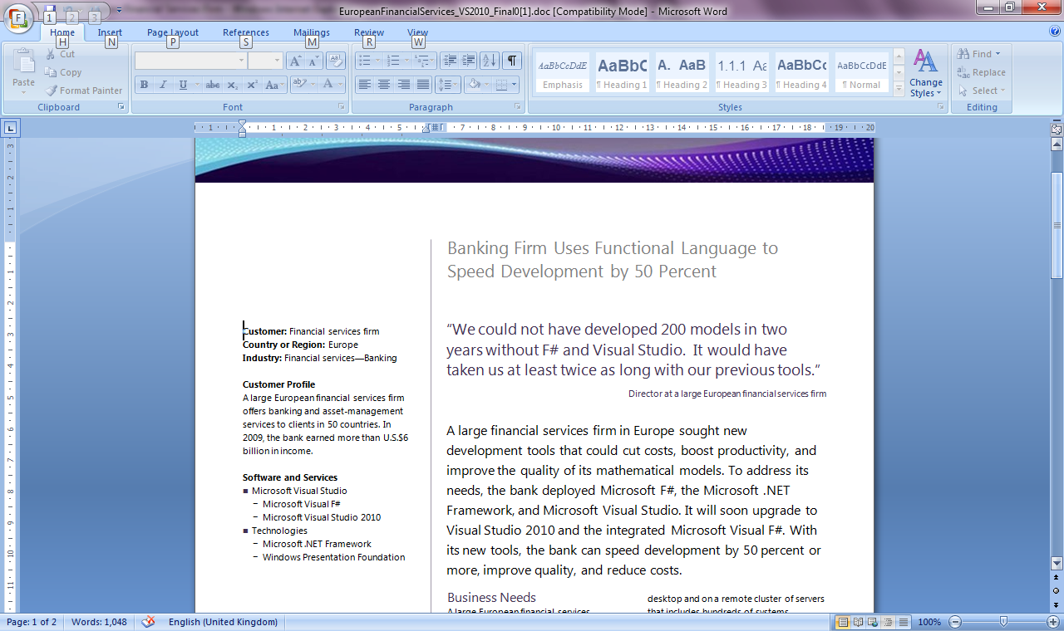
Example #2/#3: F# in Finance
Time to Market
Correctness
Time to Market
Correctness
Efficiency
http://fsharp.net

Slide 28
Example #3: F# in Insurance
I work for a large actuarial company... …Despite adopting Agile/Scrum …the usual delays, complications and sometimes …failures.
We used F#, and quickly created a system which would perform the necessary calculations highly efficiently, in parallel, and with a perfect match to the spreadsheet results.
All of the advantages which are commonly touted for F# do play out in practice. Immutability, Easy Parallelisation, Expressiveness, Testability, Conciseness, Flexibility, Productivity
[ Company name omitted ]
Time to Market
Efficiency
Correctness

Slide 29

Example #4: Finance trading platform
F# + C# for Trading Front End
Leverage F#’s features:
- extensive type system
- asynchronous workflows, agents and immutable types
- rich pattern matching and parser support
“Experienced F# developers regularly solve problems in days that would take weeks using more traditional languages…solving complex problems in an elegant and highly maintainable manner”
Time to Market
Complexity

Slide 30
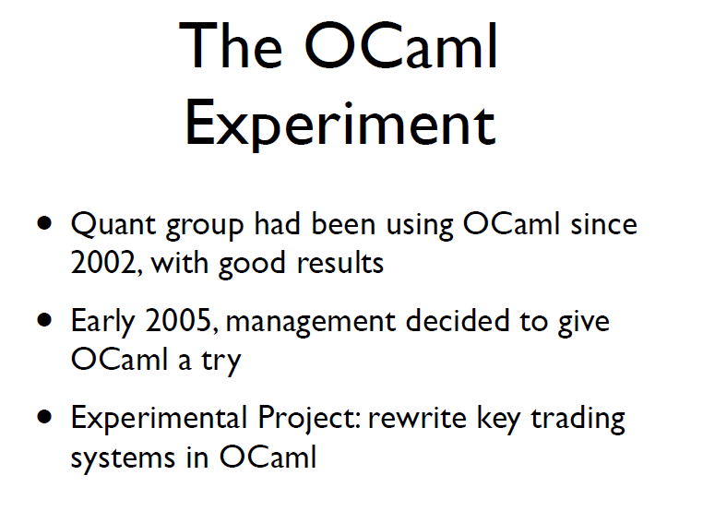
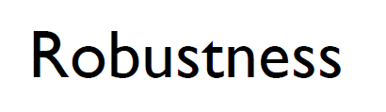
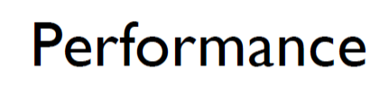
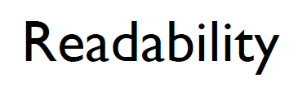
Example #5: OCaml @ Jane St
source: http://www.janestcapital.com/yaron_minsky-cufp_2006.pdf

Slide 31
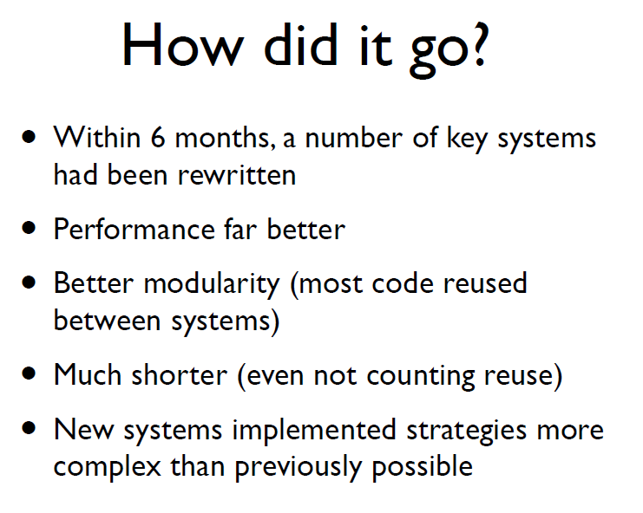
Example #5: OCaml @ Jane St
Efficiency
Solve complex problems
source: http://www.janestcapital.com/yaron_minsky-cufp_2006.pdf

Slide 32
Example #6: F# in Biotech
Efficiency
...F# rocks - building algorithms for DNA processing and it's like a drug. 12-15 at Amyris use F#... A complete genome resequencing pipeline with interface, algs, reporting in ~5K lines and it has been incredibly reliable, fast and easy to maintain.. A suffix tree in 150 lines that can index 200,000 bases a second ;)
F# v. Python: F# has been phenomenally useful. I would be writing a lot of this in Python otherwise and F# is more robust, 20x - 100x faster to run and faster to develop.
Units of measure: I started labelling the coordinates as one or zero based and immediately found a bug where I'd casually mixed the two systems. Yay F#!
Darren Platt, Amyris BioTechnologies
Correctness
Time to Market
Correctness

Slide 33
Example #7: F# in Advertisement Ranking & Rating @ Microsoft
Around 95% of the code in these projects has been developed in F#.
F# allowed for rapid development of prototypes, and thus also rapid verification or falsification of the underlying mathematical models.
Complex algorithms, for example to compute Nash equilibria in game theory, can be expressed succinctly.
Units of measure reduced the chance of errors dramatically: Prices, probabilities, derivatives, etc. can already be kept apart at compile time.
Time to Market
Taming Complexity
Correctness

Slide 34
F# at Kaggle
fsharp.org/testimonials
At Kaggle we initially chose F# for our core data analysis algorithms because of its expressiveness.
We’ve been so happy with the choice that we’ve found ourselves moving more and more of our application …into F#.
The F# code is shorter, easier to read, easier to refactor, and, because of the strong typing, contains far fewer bugs.
As our data analysis tools have developed, we’ve seen domain-specific constructs emerge very naturally
As our codebase gets larger, we become more productive.

Slide 35
Summary – The Data Agrees
Simple, correct, robust code
Interoperability improves time-to-market
Strong-typing gives efficiency
Analytical developers empowered to solve more complex problems

Slide 36
The Alternative View 10 Reasons Not to Use a Strongly Typed Functional Language

Slide 37
A chat about nulls….

Slide 38
Part 3 – F# in Practice

Slide 39
Understanding F#
F# 1.0
F# 2.0
C# (designers)
F# (code)
WebSharper/
Javascript (HTML5)
F# 3.0
Code
Analysis
Algorithms
Parallel
Data
Information
Services
Presentation
Publication
UI

Slide 40
Lesson: Combining with the right tools is key

Slide 41
Examples
A quant model
A trading engine
F# + existing C++ components
A calculation engine with GPU execution
F# + Alea.cuBase GPU Framework
A scalable web service
Data Services + F# + ASP.NET
A scalable big-data service
F# + Hadoop + ServiceStack
A Web 2.0 startup
F# (Server) + SQL Server + DataFeeds + ASP.NET + F# (WebSharper) + HTML5
Oracle + F# (Server) + F#/C# (Silverlight)

Slide 42
F# in Practice: More Lessons
Build capabilities in functional-first techniques
Training is key
Trial on specific components, prototyping, testing and exploration
✗ Don’t rewrite stable, working components in F#
✗ Always reuse C++ high-performance components.

Slide 43
Part 4 – What’s Going on with F#?

Slide 44
Visual F# tools are part of Visual Studio F# as a language is Open Source, is Cross Platform
fsharp.org
fsharp.org/use/mac
fsharp.org/use/linux
fsharp.org/use/android
fsharp.org/use/ios
fsharp.org/use/windows
fsharp.org/use/freebsd

Slide 45
http://fsharp.org

Slide 46
F# is changing…
F# runs on many platforms
“F# is for Windows”

Slide 47












New think…
Visual Studio, .
.NET, SDKs, Tools
…
Visual F# Tools
F# Language
F# Open Source
Group
tryfsharp.org
F# Software
Foundation
F# Community
Groups
fpish.net
tryfs.org
fssnip.net
tryfs.org
fsharpforfunandprofit.com
Xamarin Studio

Slide 48








Tour: IDEs

Slide 49
New: Tsunami Scripting Tools http://tsunami.io demo videos

Slide 50
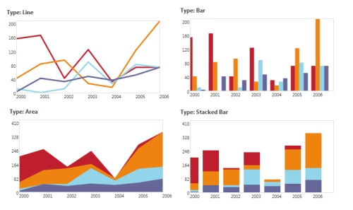
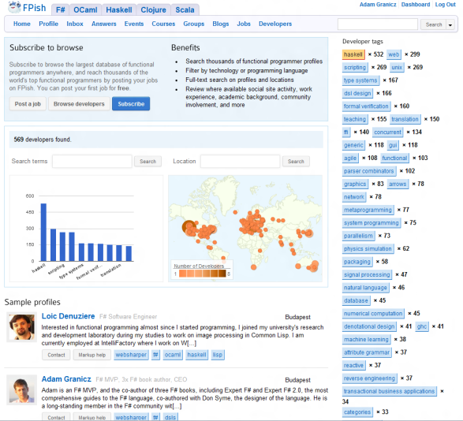


WebSharper
Web and Mobile Framework for F#
http://websharper.com
#websharper
Mature, enterprise-ready
Write all your server+client code in F#
Get a complete web or mobile application
Interface with any client-side JS library via F#
Powerful functional web abstractions
Automatic resource management
Safe URLs, type-safe URLs
and much-much more…
Develop applications with
Less code - 50-90% less
Quicker to develop – on average we find 2-3x
Easier to maintain – Significant $$ savings

Slide 51
FunScript
Converts F# to Javascript through F# quotations
Community made, open-source
Open source license
TypeScript Type Provider for interop

Slide 52
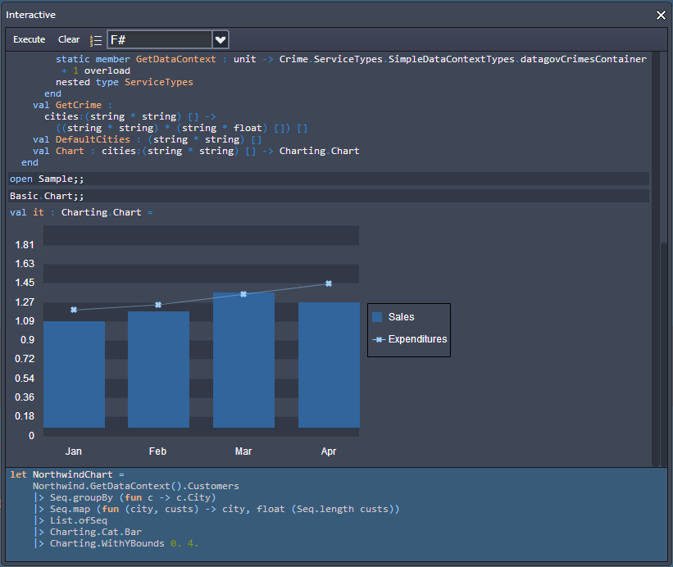
Upcoming:CloudSharper
http://cloudsharper.com
F# Development Environment in the Cloud
Full F# language support
Multi-project solutions
Web and mobile Apps
Syntax highlighting
On the fly type checking
Interactive exploration
Integration with data
Support for type providers

Slide 53
Recent Developments in F# @ Microsoft
F# 3.0
F# + Azure
F# + Azure Hadoop
F# + Azure Cloud Numerics
queries, powerful data integration, better tooling, portable libraries
for scalable service programming
for scalable big-data programming
for scalable math programming

Slide 54
Some Other Developments in F#
F# + WebSharper
F# + FCore
F# + m-brace
F# + …
very powerful cross-platform HTML5 web/mobile programming
for statistical/math programming + GPU
a cloud-execution framework
many other { open-source, .NET, C#, F#, … }
F# + R
R Provider for F#, access > 2000 R packages

Slide 55
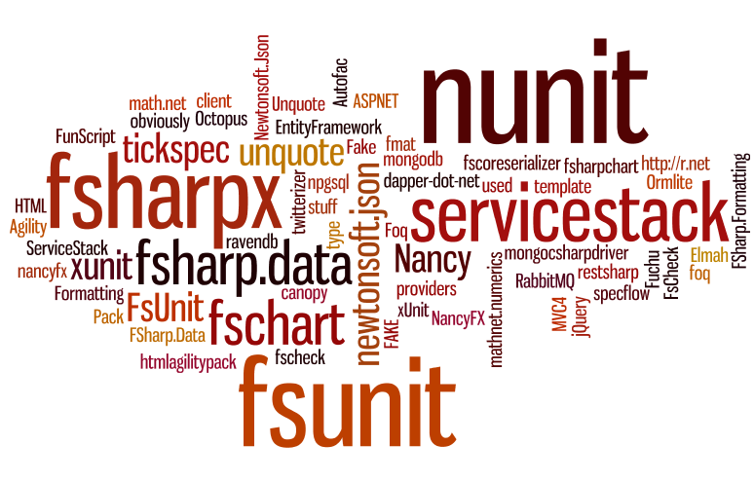

Slide 56
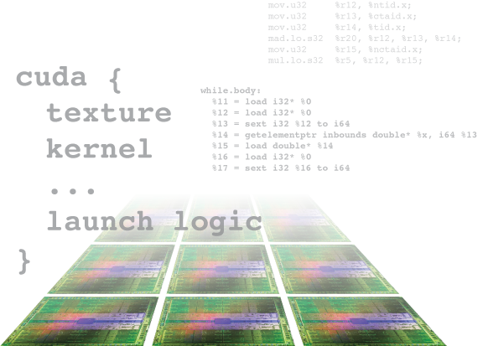
Alea.cuBase
Complete solution to develop CUDA accelerated GPU applications
Used “for real” in finance institutions
Based on LLVM and CUDA 5 technology
Uses F# code quotation
Source code solution
No wrappers, no post build process to transform IL code
Dynamic code
generation
GPU algorithm
scripting
Industry grade
performance
Rapid
development
Solid framework
for reusability
Advanced CUDA programming

Slide 57
In Summary – Functional-First Languages
F.F.
Reduced time to market
Functional-first = real value
Efficient execution
Rapid, correct development
Solve complex problems

Slide 58
In Summary – F#
F#
Succeed with functional-first in industry today
Robust code in the modern enterprise
A bright future ahead for web/data/cloud
Open-source, cross-platform, strongly typed, supported

Slide 59
Learn more at fsharp.org Questions?

